Slide 1



Rosemary
Where Every Cup Tells A Story
Rezzag Nadjia
Hachani Chaima
Guellil Imane
Ladjdel Yasmine

Slide 2
Introduction
Rosemary , a online coffee shop website inspired by a cozy and welcoming café vibe, and the idea was to create a place where people feel comfortable, even online, just like they would in a real coffee shop.
The purpose of Rosemay is to allow customers to explore and buy different flavors of desserts and drinks, available in different sizes, in a simple and pleasant way.
Our target audience includes students, workers, and anyone who enjoys coffee, desserts, and relaxed spaces.
Motivation
The website is organized into clear sections such as Home, Menu, About, and Contact, so users can navigate easily and enjoy their experience.

Slide 3
Tchnologies used
In our web we used as languages: Html, CSS, JAVASCRIPT, PHP, MYSQL
Functionallities
User Authentication (Login / Sign Up)
Product Browsing
Shopping Cart Management
Order Confirmation and Checkout
Delivery Management
Product Rating
Dark mode

Slide 4


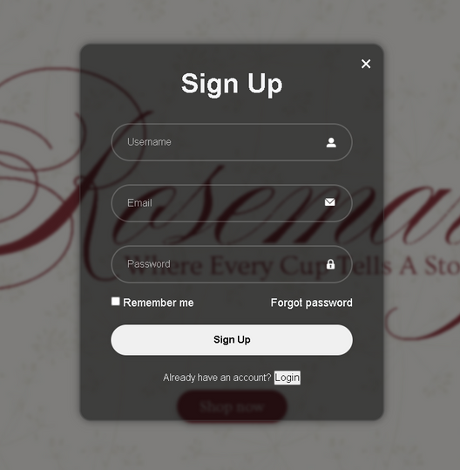
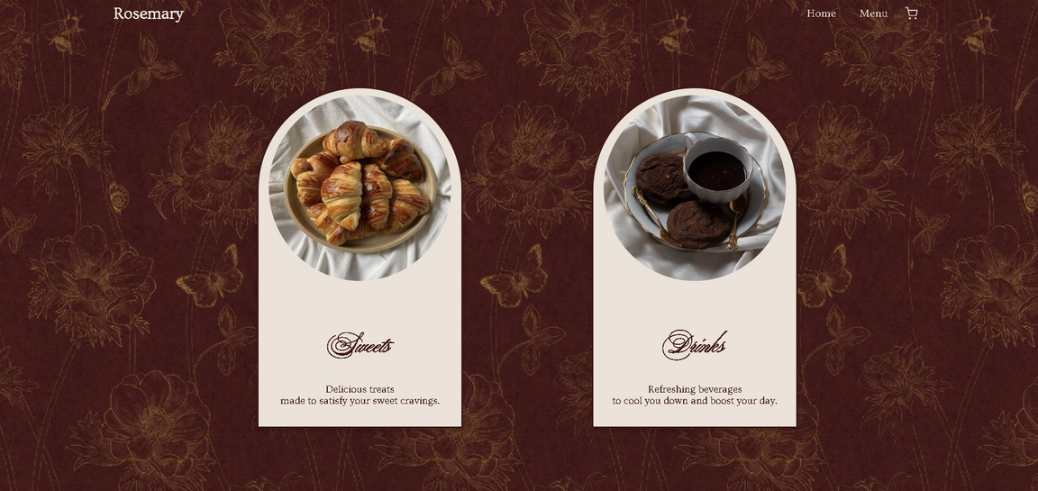
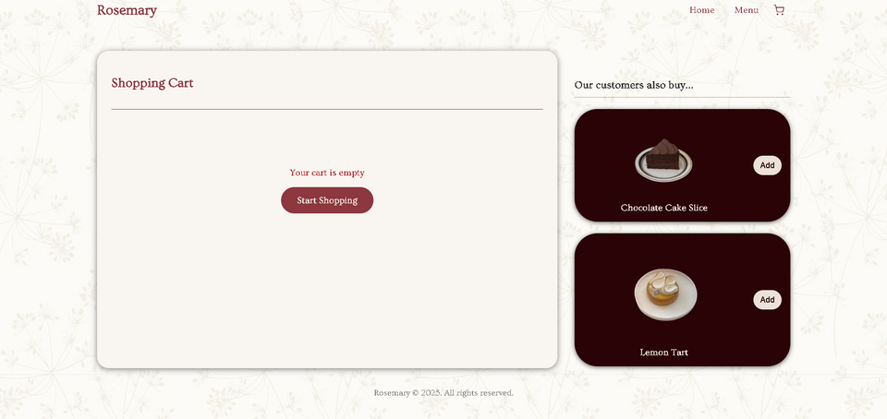
Functionallities

Slide 5
Thank You

